Slide 1





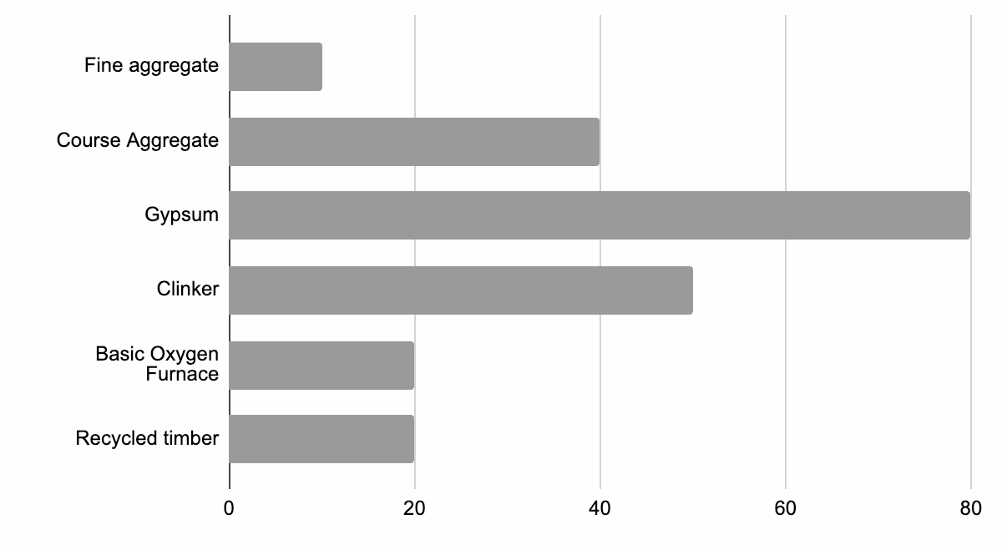
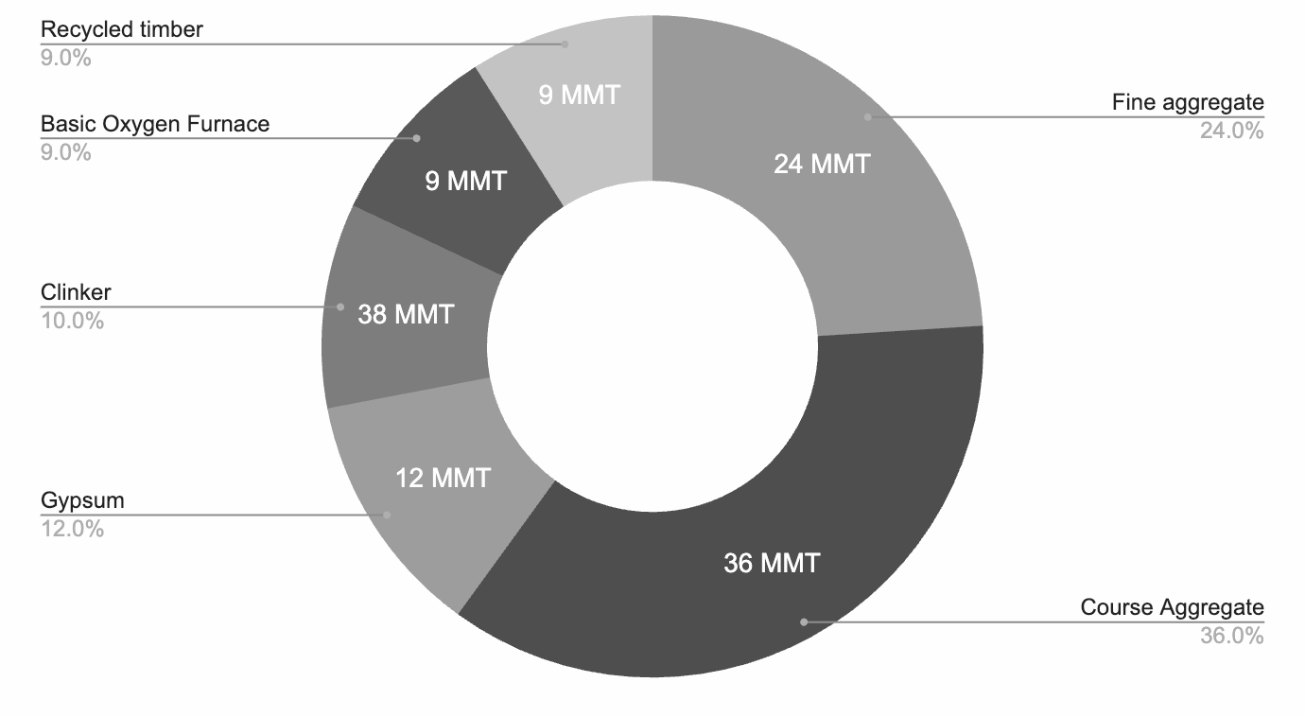

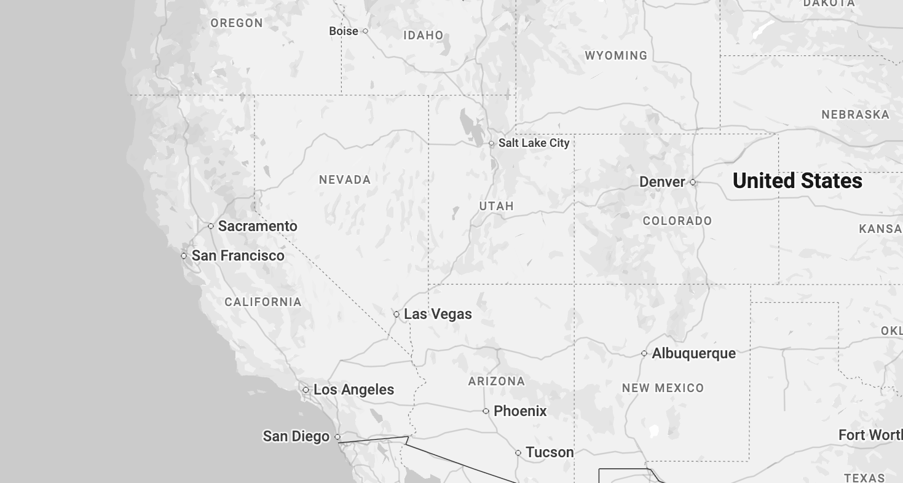

LANDING PAGE
Building Supply chain Material Analysis and Risk Trade-off Tool (BuildSMART v1) Main Page About Contact
Location Search
BASELINE MATERIAL DEMAND
BASELINE MATERIAL COST
Building Specifications
To estimate the baseline material demand and cost for military building(s), select a location, expand the ‘Building Specifications’ tab, and enter the requested parameters.
To evaluate impacts of different stressors on material availability, expand the ‘Material Availability Scenarios’ tab and toggle on relevant scenarios.
To explore the impacts of material substitutions, expand the ‘Alternative Materials’ tab and adjust the utilization rate of relevant materials.
Welcome to the Building Supply chain Material Analysis and Risk Trade-off (BuildSMART) Tool
Material Availability Scenarios
Off
Alternative Materials
Off
Off
Sankey diagram
Material Cost (USD)
PROJECTED MATERIAL DEMAND
PROJECTED MATERIAL AVAILABILITY
Sankey diagram
Off
CONSTRUCTION YEAR
CONSTRUCTION YEAR
2020 2030 2040 2050 2060 2070
2020 2030 2040 2050 2060 2070

Slide 2
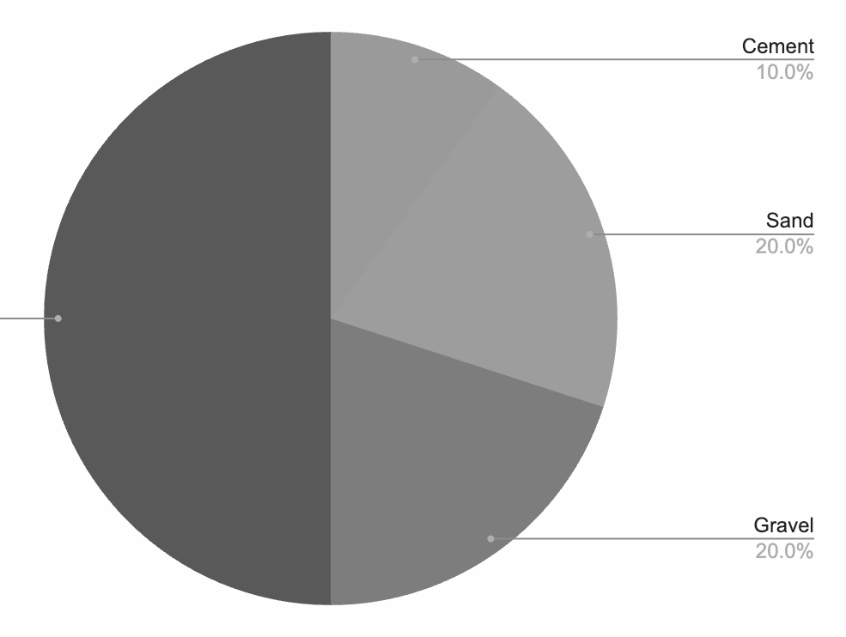
BUILDING SELECTION
Building Supply chain Material Analysis and Risk Trade-off Tool (BuildSMART v1) Main Page About Contact
Ventura County, CA
BASELINE MATERIAL DEMAND
BASELINE MATERIAL COST
Building Specifications
Reuse
materials?
Building archetype
Size (sq. ft)
Aircraft maintenance
Health services
Laboratory
Office
Sankey diagram
Off
Material Cost (USD)
Off
Material Availability Scenarios
PROJECTED MATERIAL DEMAND
PROJECTED MATERIAL AVAILABILITY
Alternative Materials
Off
Sankey diagram
Off
CONSTRUCTION YEAR
CONSTRUCTION YEAR
2020 2030 2040 2050 2060 2070
2020 2030 2040 2050 2060 2070

Slide 3
BUILDING SELECTION
Building Supply chain Material Analysis and Risk Trade-off Tool (BuildSMART v1) Main Page About Contact
Ventura County, CA
BASELINE MATERIAL DEMAND
BASELINE MATERIAL COST
Building Specifications
Reuse
materials?
Health services
10,000
Estimate material demands and cost
Material Availability Scenarios
Off
Sankey diagram
Off
Material Cost (USD)
Alternative Materials
Off
PROJECTED MATERIAL DEMAND
PROJECTED MATERIAL AVAILABILITY
Sankey diagram
Off
CONSTRUCTION YEAR
CONSTRUCTION YEAR
2020 2030 2040 2050 2060 2070
2020 2030 2040 2050 2060 2070

Slide 4
BUILDING SELECTION
Building Supply chain Material Analysis and Risk Trade-off Tool (BuildSMART v1) Main Page About Contact
Ventura County, CA
BASELINE MATERIAL DEMAND
BASELINE MATERIAL COST
Building Specifications
Reuse
materials?
Health services
10,000
Laboratory
20,000
Estimate material demands and cost
Sankey diagram
Off
Material Cost (USD)
Material Availability Scenarios
Off
PROJECTED MATERIAL DEMAND
PROJECTED MATERIAL AVAILABILITY
Alternative Materials
Off
Sankey diagram
Off
CONSTRUCTION YEAR
CONSTRUCTION YEAR
2020 2030 2040 2050 2060 2070
2020 2030 2040 2050 2060 2070

Slide 5
BUILDING SELECTION
Building Supply chain Material Analysis and Risk Trade-off Tool (BuildSMART v1) Main Page About Contact
Ventura County, CA
BASELINE MATERIAL DEMAND
BASELINE MATERIAL COST
Building Specifications
New buildings
Reuse
materials?
Health services
10,000
Laboratory
20,000
Demolished buildings
Sankey diagram
Off
Material Cost (USD)
Barracks
50,000
Estimate material demands and cost
PROJECTED MATERIAL DEMAND
PROJECTED MATERIAL AVAILABILITY
Material Availability Scenarios
Off
Alternative Materials
Off
Sankey diagram
Off
CONSTRUCTION YEAR
CONSTRUCTION YEAR
2020 2030 2040 2050 2060 2070
2020 2030 2040 2050 2060 2070

Slide 6
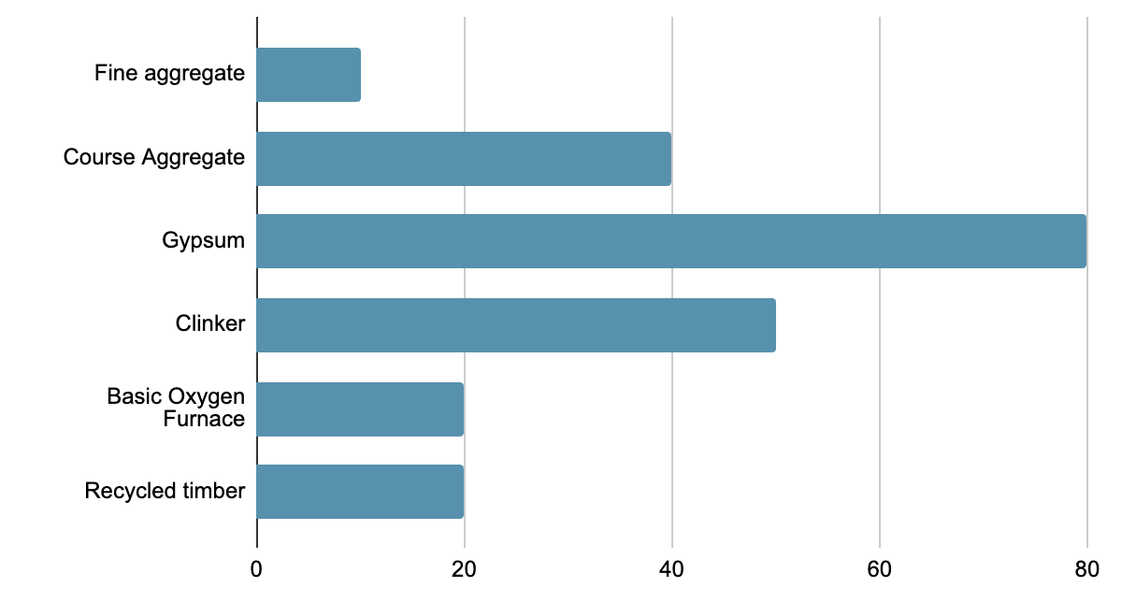
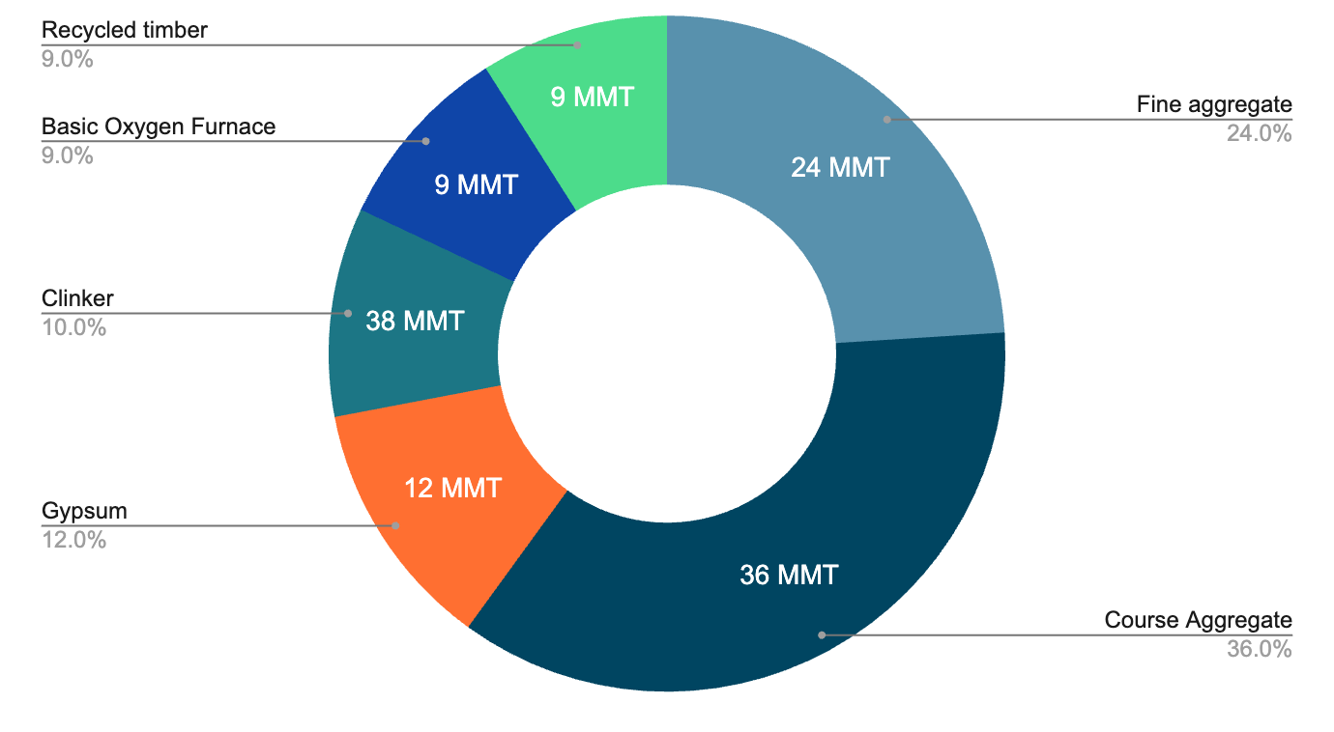
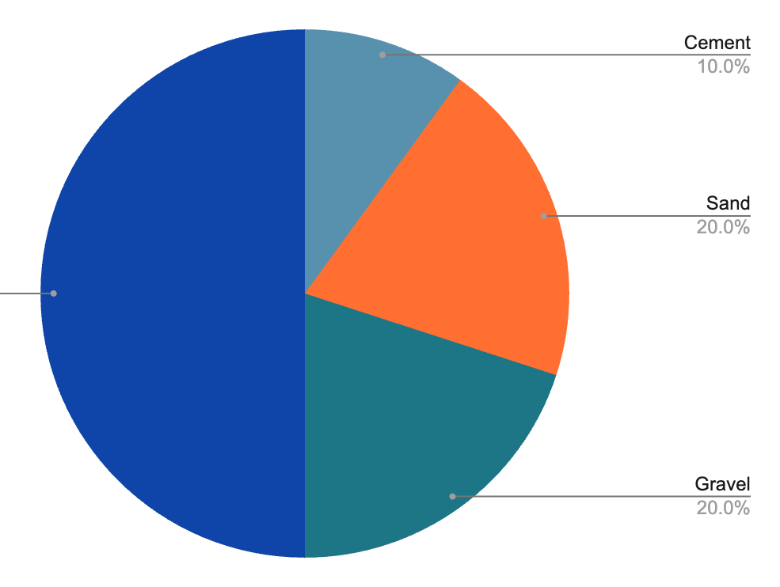

BASELINE MATERIALS & COST
Building Supply chain Material Analysis and Risk Trade-off Tool (BuildSMART v1) Main Page About Contact
Ventura County, CA
BASELINE MATERIAL DEMAND
BASELINE MATERIAL COST
Building Specifications
Legend
New buildings
Reuse
materials?
Reused material
Health services
10,000
Laboratory
20,000
Demolished buildings
Sankey diagram
On
Material Cost (USD)
Barracks
50,000
Estimate material demands and cost
PROJECTED MATERIAL DEMAND
PROJECTED MATERIAL AVAILABILITY
Material Availability Scenarios
Off
Alternative Materials
Off
Sankey diagram
Off
CONSTRUCTION YEAR
CONSTRUCTION YEAR
2020 2030 2040 2050 2060 2070
2020 2030 2040 2050 2060 2070

Slide 7
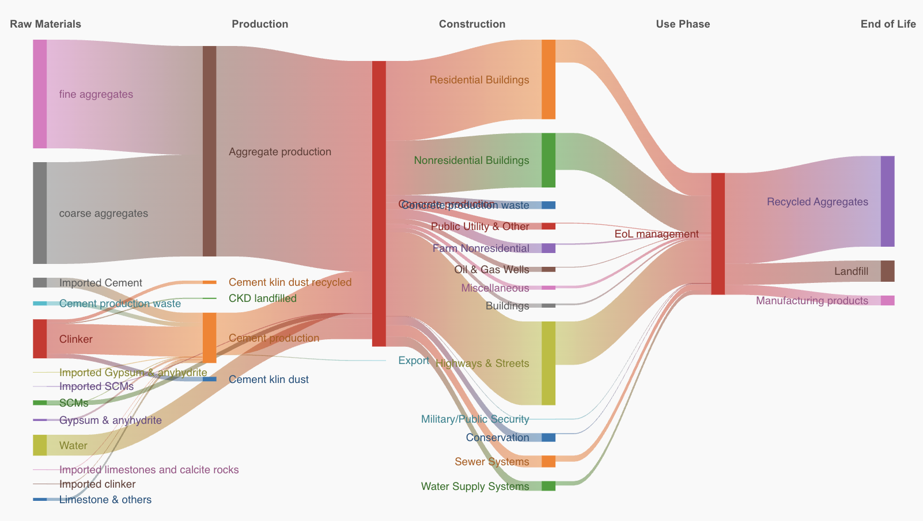
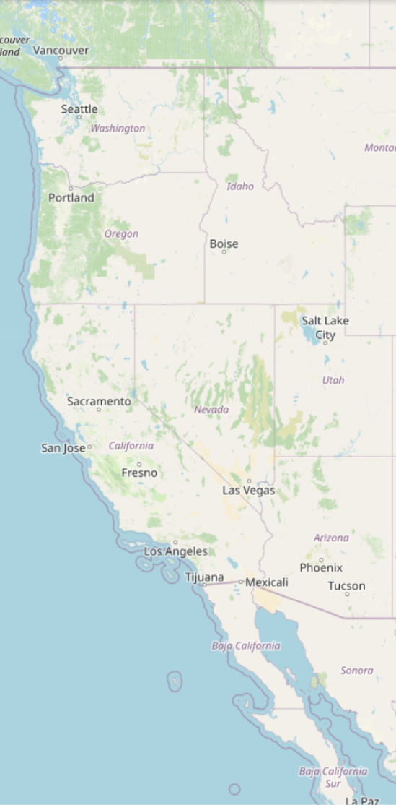
SANKEY DIAGRAM
Building Supply chain Material Analysis and Risk Trade-off Tool (BuildSMART v1) Main Page About Contact
Ventura County, CA
CONSTRUCTION YEAR
2020 2030 2040 2050 2060 2070 2080
Building Specifications
Sankey diagram
Off
New buildings
Reuse
materials?
Health services
10,000
Legend
Laboratory
20,000
Reused material
MATERIAL DEMAND
Demolished buildings
Barracks
50,000
Estimate material demands and cost
Material Availability Scenarios
Off
Alternative Materials
Off
MATERIAL COST
Material Cost (USD)

Slide 8
BASELINE MATERIALS & COST
Building Supply chain Material Analysis and Risk Trade-off Tool (BuildSMART v1) Main Page About Contact
Ventura County, CA
BASELINE MATERIAL DEMAND
BASELINE MATERIAL COST
Building Specifications
Legend
New buildings
Reuse
materials?
Reused material
Health services
10,000
Laboratory
20,000
Demolished buildings
Sankey diagram
Off
Material Cost (USD)
Barracks
50,000
Estimate material demands and cost
PROJECTED MATERIAL DEMAND
PROJECTED MATERIAL AVAILABILITY
Material Availability Scenarios
Off
Alternative Materials
Off
Sankey diagram
Off
CONSTRUCTION YEAR
CONSTRUCTION YEAR
2020 2030 2040 2050 2060 2070
2020 2030 2040 2050 2060 2070

Slide 9
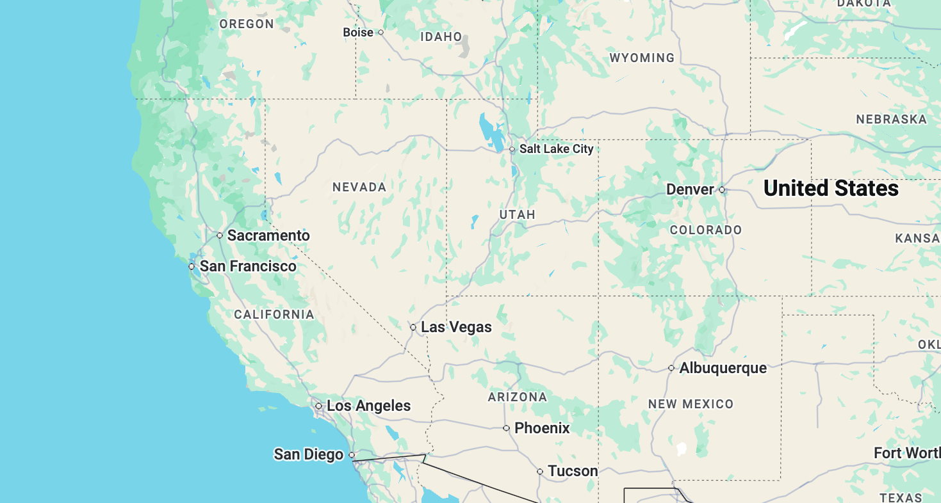
PROJECTED DEMAND & AVAILABILITY
Building Supply chain Material Analysis and Risk Trade-off Tool (BuildSMART v1) Main Page About Contact
Ventura County, CA
BASELINE MATERIAL DEMAND
BASELINE MATERIAL COST
Building Specifications
Legend
New buildings
Reuse
materials?
Reused material
Health services
10,000
Laboratory
20,000
Demolished buildings
Sankey diagram
Off
Material Cost (USD)
Barracks
50,000
Estimate material demands and cost
PROJECTED MATERIAL DEMAND
PROJECTED MATERIAL AVAILABILITY
Material Availability Scenarios
Off
Legend
Reused material
Off
Limited availability
Alternative Materials
Sankey diagram
Off
CONSTRUCTION YEAR
CONSTRUCTION YEAR
2020 2030 2040 2050 2060 2070
2020 2030 2040 2050 2060 2070

Slide 10
PROJECTED DEMAND & AVAILABILITY
Building Supply chain Material Analysis and Risk Trade-off Tool (BuildSMART v1) Main Page About Contact
Ventura County, CA
BASELINE MATERIAL DEMAND
BASELINE MATERIAL COST
Building Specifications
Legend
New buildings
Reuse
materials?
Reused material
Health services
10,000
Laboratory
20,000
Demolished buildings
Sankey diagram
Off
Material Cost (USD)
Barracks
50,000
Estimate material demands and cost
PROJECTED MATERIAL DEMAND
PROJECTED MATERIAL AVAILABILITY
Material Availability Scenarios
Off
Legend
Reused material
Off
Limited availability
Alternative Materials
Sankey diagram
Off
CONSTRUCTION YEAR
CONSTRUCTION YEAR
2020 2030 2040 2050 2060 2070
2020 2030 2040 2050 2060 2070

Slide 11
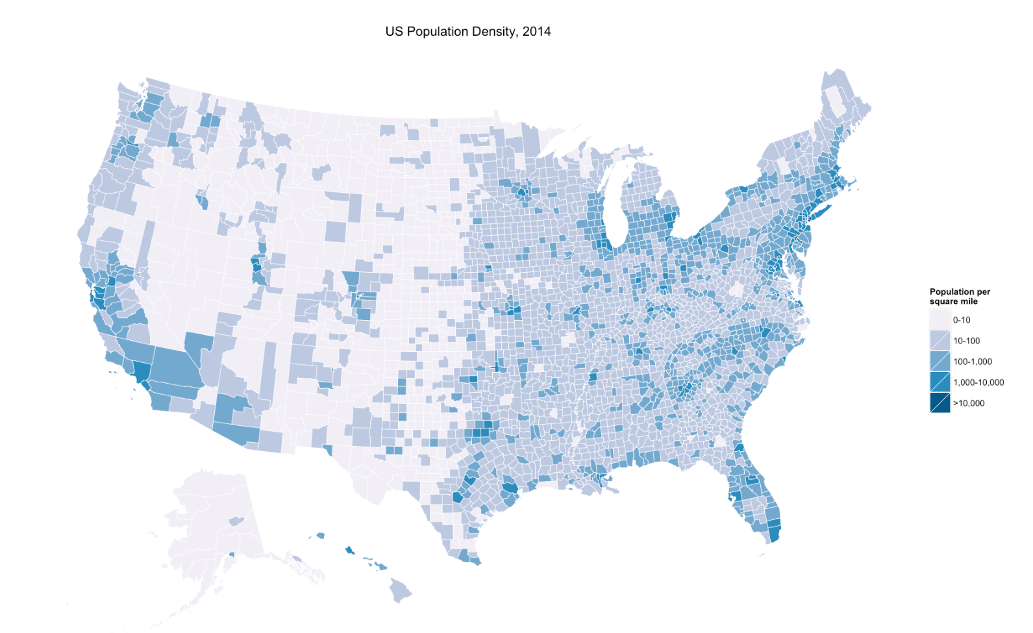
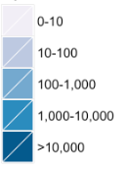
MATERIAL AVAILABILITY CHOROPLETH
Building Supply chain Material Analysis and Risk Trade-off Tool (BuildSMART v1) Main Page About Contact
Material
BASELINE MATERIAL DEMAND
BASELINE MATERIAL COST
Ventura County, CA
Fly ash
Blast furnace slag
Steel
Concrete
…
Building Specifications
Legend
New buildings
Reuse
materials?
Reused material
Availability Scenario
Health services
10,000
High domestic import reliance
Regional resource scarcity
Reduced circularity opportunities
…
Laboratory
20,000
Material availability
Demolished buildings
Sankey diagram
Off
Material Cost (USD)
Barracks
50,000
Estimate material demands and cost
PROJECTED MATERIAL DEMAND
PROJECTED MATERIAL AVAILABILITY
Material Availability Scenarios
Off
Legend
Reused material
Off
Limited availability
Alternative Materials
Sankey diagram
Off
CONSTRUCTION YEAR
CONSTRUCTION YEAR
2020 2030 2040 2050 2060 2070
CONSTRUCTION YEAR
2020 2030 2040 2050 2060 2070
2020 2030 2040 2050 2060 2070

Slide 12
MATERIAL AVAILABILITY SCENARIOS
Building Supply chain Material Analysis and Risk Trade-off Tool (BuildSMART v1) Main Page About Contact
Building Supply chain Material Analysis and Risk Trade-off Tool (BuildSMART v1) Main Page About Contact
Ventura County, CA
BASELINE MATERIAL DEMAND
BASELINE MATERIAL COST
Building Specifications
Legend
Reused material
Material Availability Scenarios
On
High domestic import reliance
Regional resource scarcity
Reduced circularity opportunities
…
Increased dependence on coal
Sankey diagram
Off
Material Cost (USD)
Estimate impact of scenario
PROJECTED MATERIAL DEMAND
PROJECTED MATERIAL AVAILABILITY
Alternative Materials
Off
Legend
Reused material
Limited availability
Sankey diagram
Off
CONSTRUCTION YEAR
CONSTRUCTION YEAR
2020 2030 2040 2050 2060 2070
2020 2030 2040 2050 2060 2070

Slide 13
MATERIAL AVAILABILITY SCENARIOS
Building Supply chain Material Analysis and Risk Trade-off Tool (BuildSMART v1) Main Page About Contact
Building Supply chain Material Analysis and Risk Trade-off Tool (BuildSMART v1) Main Page About Contact
Ventura County, CA
BASELINE MATERIAL DEMAND
BASELINE MATERIAL COST
Building Specifications
Legend
Reused material
Material Availability Scenarios
On
High domestic import reliance
Regional resource scarcity
Reduced circularity opportunities
…
Increased dependence on coal
Sankey diagram
Off
Material Cost (USD)
Estimate impact of scenario
PROJECTED MATERIAL DEMAND
PROJECTED MATERIAL AVAILABILITY
Supply Chain Vulnerability Explanation: Reducing import ability primarily affects Gypsum, a raw material necessary for concrete production. Added cost is due is primarily associated with shifting to domestic production. Possible mitigation strategies include substitution with example alternative material…
Legend
Reused material
Limited availability
Sankey diagram
Off
Alternative Materials
Off
CONSTRUCTION YEAR
CONSTRUCTION YEAR
2020 2030 2040 2050 2060 2070
2020 2030 2040 2050 2060 2070

Slide 14
ALTERNATIVE MATERIALS
Building Supply chain Material Analysis and Risk Trade-off Tool (BuildSMART v1) Main Page About Contact
Ventura County, CA
BASELINE MATERIAL DEMAND
BASELINE MATERIAL COST
Building Specifications
Legend
Reused material
Material Availability Scenarios
Off
On
Alternative Materials
Recycled timber
Fly ash
Blast furnace slag
Recycled steel
…
Sankey diagram
Off
Material Cost (USD)
0%
100%
0%
100%
PROJECTED MATERIAL DEMAND
PROJECTED MATERIAL AVAILABILITY
0%
100%
0%
100%
Legend
Reused material
Estimate impact of material substitutions
Limited availability
Sankey diagram
Off
CONSTRUCTION YEAR
CONSTRUCTION YEAR
2020 2030 2040 2050 2060 2070
2020 2030 2040 2050 2060 2070

